Slide 1

DriverPass System Analysis
Mustafa Alsouqi
Notes:
[No speaker notes required for this slide.]

Slide 2

System Requirements
Functional Requirements:
The system shall allow users to schedule, modify, and cancel lessons online.
The system shall validate user credentials upon login.
Nonfunctional Requirements:
The system must load pages and respond to actions within 2 seconds.
The system must encrypt all communication using HTTPS.
Notes:
For functional requirements, I included features that directly enable the core functionalities of the system. These include the ability for users to schedule, modify, and cancel lessons online. This meets DriverPass’s goal of providing users with flexibility and convenience in managing their training. Additionally, the system validates user credentials upon login, ensuring secure and personalized access for each user. These features directly support DriverPass’s vision of making driver training accessible and efficient. Nonfunctional requirements focus on performance, security, and reliability. For example, the system must load pages and respond to user actions within 2 seconds, for a smooth user experience. Communication between users and the system will be encrypted using HTTPS, which addresses data security concerns and protects sensitive user information. These requirements ensure that the system remains fast, secure, and dependable, meeting the expectations of both customers and staff. Together, these requirements create a foundation for delivering the quality of service DriverPass is aiming for.

Slide 3
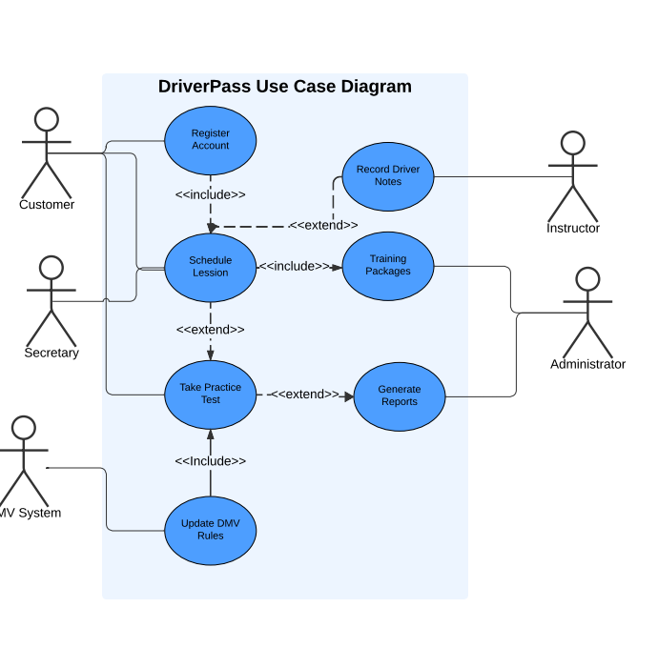
Use Case Diagram
Notes:
This diagram illustrates how the DriverPass system interacts with its different users and functionalities to meet their needs. The system supports several types of users, including customers, secretaries, instructors, administrators, and the DMV system. Each user has specific roles and tasks they perform within the system. For example, customers can register for accounts, schedule driving lessons, and take practice tests. These features were designed to give customers control and flexibility over their training. Secretaries assist customers by helping them schedule lessons and manage reservations, ensuring a smooth process for those who prefer offline interactions. Instructors can record lesson details, such as driver notes, which help track a customer's progress. The system also integrates administrative functions, allowing administrators to manage training packages and generate detailed reports on user activity. This supports the business side of DriverPass by enabling efficient management and monitoring. Additionally, the system stays up-to-date with DMV requirements by allowing updates to rules and policies directly from the DMV system. This ensures that training materials and tests are accurate and compliant. The design ensures that all the features align with DriverPass's goals of offering high-quality, convenient training and effective operational management. It also provides flexibility, security, and scalability to support the company’s growth and evolving needs.

Slide 4
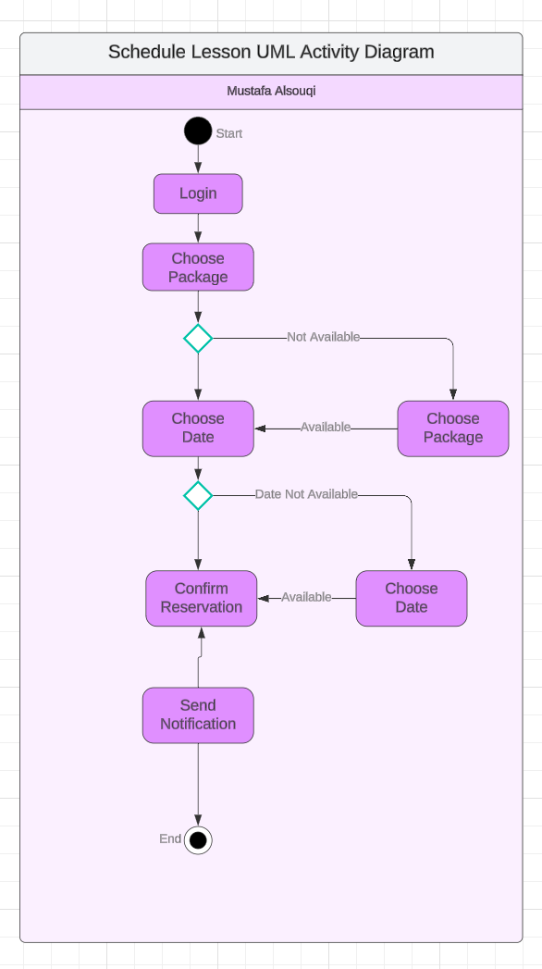
Activity Diagram
Notes:
This activity diagram explains the process of scheduling a lesson in the DriverPass system. The use case begins when the customer logs into their account to book a driving lesson. Once logged in, the customer chooses a training package that fits their needs. If the selected package is unavailable, the system allows the customer to go back and pick another package. After selecting a package, the customer chooses a date and time for their lesson. The system checks if the selected date and time are available. If the chosen slot is not available, the customer is prompted to pick another date. If the date and time are available, the system confirms the reservation and sends a notification to the customer to confirm the details of their booking. This design ensures the system meets DriverPass’s needs for flexibility and convenience. Customers can book their lessons online, receive immediate feedback if their chosen slot is unavailable, and get confirmation of their reservation. This process creates a smooth experience for customers and allows DriverPass to manage lesson schedules efficiently.

Slide 5
Security
Key Security Features:
Data encryption using HTTPS.
Password authentication with optional multi-factor authentication.
Temporary account lockouts after failed login attempts.
Role-based access control for permissions.
Notes:
Security is a top priority for DriverPass to protect customer data and system integrity. The system uses secure logins and encryption to keep personal and payment information safe during use. To prevent unauthorized access, the system automatically locks accounts after too many failed login attempts. Additionally, the system limits what each user can do based on their role. For example, customers can book lessons, but only administrators can update account permissions. These steps ensure the system remains safe, reliable, and easy to use for all users.

Slide 6
System Limitations
The system does not currently include real-time communication features, such as live chat between users and staff.
Advanced DMV integrations, such as automatic syncing for rule updates, may be limited due to budget constraints.
The system relies on users having a stable internet connection to access features like lesson scheduling and practice tests.
Initial customization options for training packages will require technical assistance from a developer.
Notes:
While the DriverPass system meets its core goals, there are a few limitations to consider. First, real-time communication features, like live chat, are not included in this version. This means users will need to contact staff through more traditional methods, such as phone or email, if they have immediate questions. Second, while the system connects to DMV updates, budget constraints may limit more advanced automatic features. Updates will still require some manual adjustments by staff. Additionally, since the system is cloud-based, users will need a reliable internet connection to access their accounts and schedule lessons. Lastly, any major changes to the training packages, like adding or removing them, will require technical help from a developer. However, administrators can still disable packages if they’re no longer needed. Despite these limitations, the system is designed to be reliable, secure, and easy to use for both customers and staff.

